Slide 1
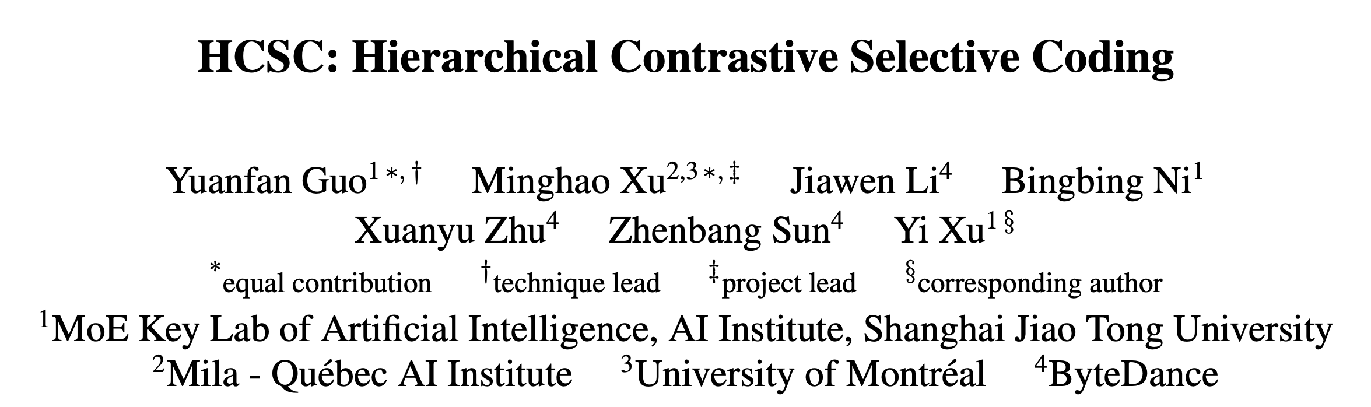
Speaker: Xiujie Song
The IEEE / CVF Computer Vision and Pattern Recognition Conference (CVPR), 2022.

Slide 2
Outline
Introduction
Preliminaries
HCSC
Experiments
Conclusions

Slide 3
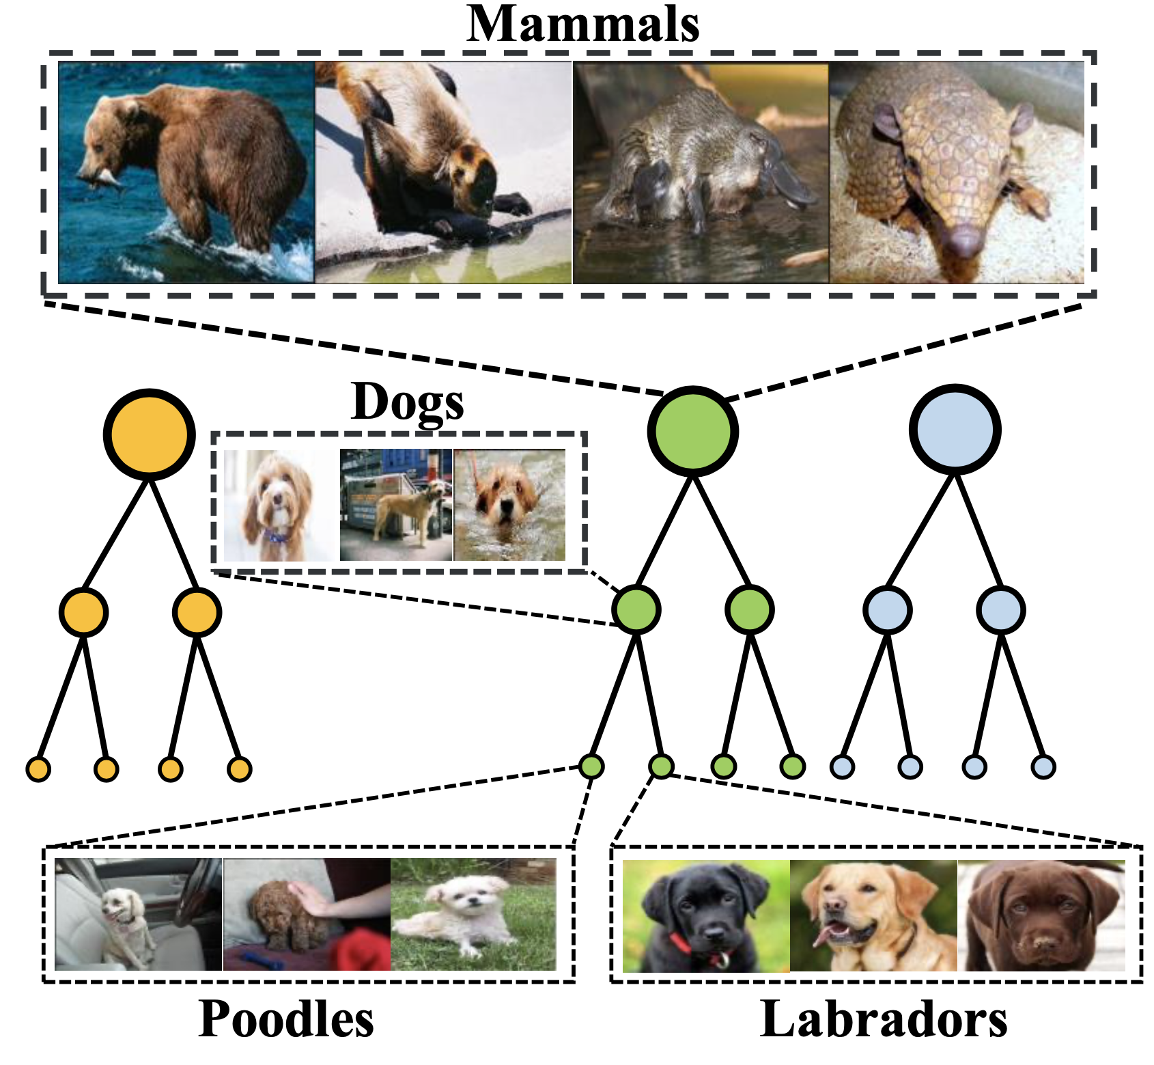
Introduction: Background
Background: Hierarchical structures naturally exist in image datasets.

Slide 4
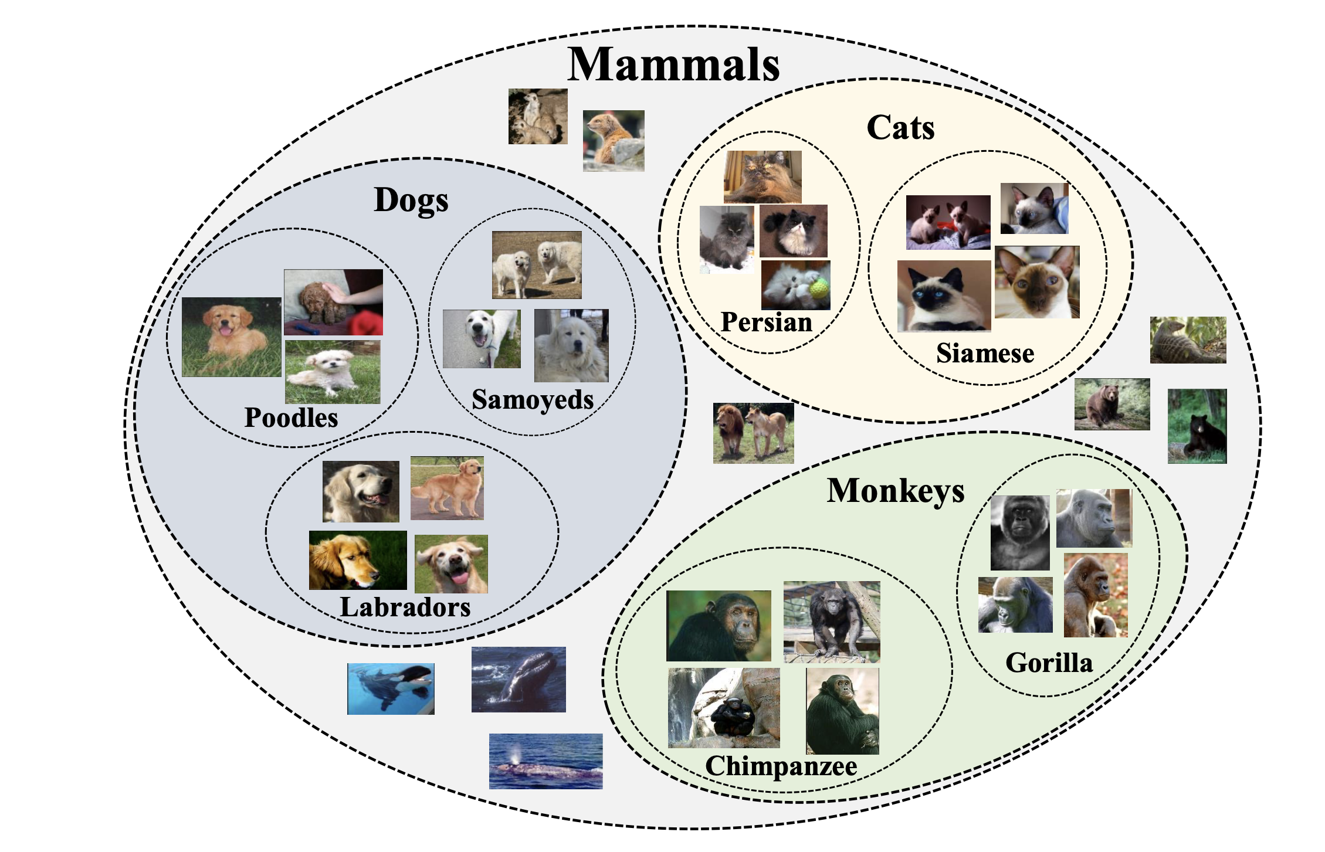
Introduction: Background
Problem:
How to learn representations that embrace such hierarchical semantic structures?

Slide 5
Outline
Introduction
Preliminaries
HCSC
Experiments
Conclusions

Slide 6
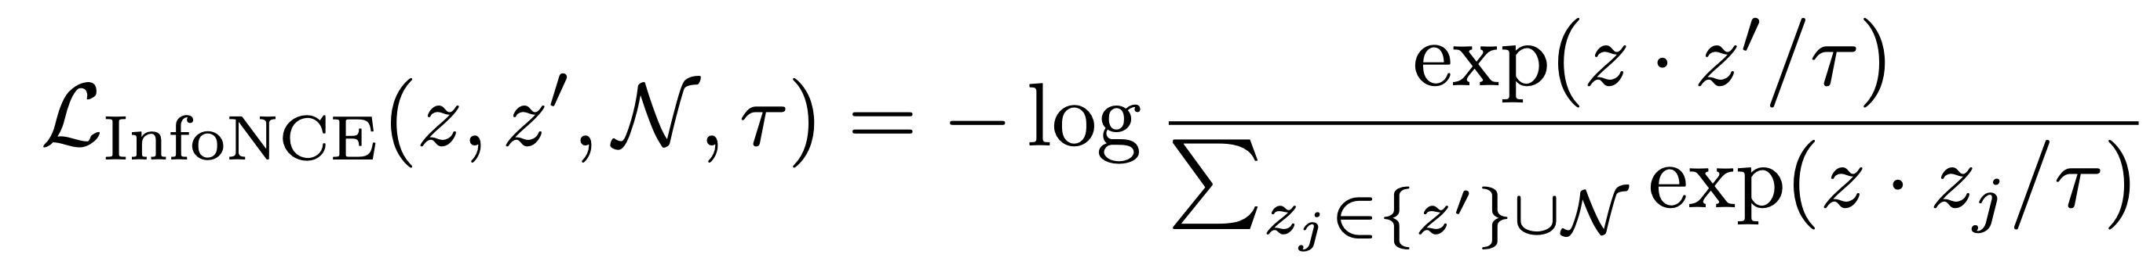
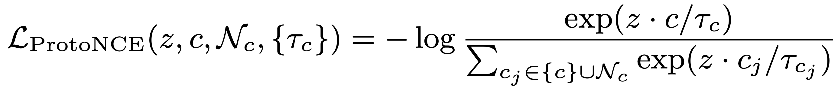



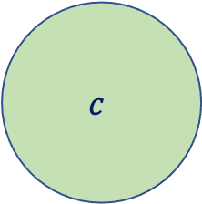

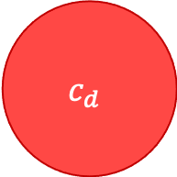

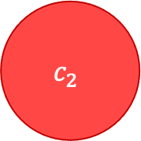

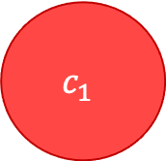
Preliminaries: Self-supervised Contrastive Representation Learning
Existing Contrastive Learning Approaches:
Instance-wise Contrastive Learning
Prototypical Contrastive Learning
$$z_{d}$$
$$z_{1}$$
$$c_{d}$$
$$c_{1}$$
$$z_{2}$$
$$z$$
$$c$$
$$z$$
$$c_{2}$$
$$z^{′}$$
Limitations:
The ability to make use of hierarchical semantic structures.
Negative pairs are not guaranteed to be semantically distinct.

Slide 7
Outline
Introduction
Preliminaries
HCSC
Experiments
Conclusions

Slide 8
HCSC: Hierarchical Contrastive Selective Coding
Goal:
Capture hierarchical semantics
Improve contrastive representation learning
Select better negative pairs
HCSC:
Hierarchical Semantic Representation
Instance-wise Contrastive Selective Coding (ICSC)
Prototypical Contrastive Selective Coding (PCSC)

Slide 9
HCSC: Hierarchical Semantic Representation
Core: construct and maintain the hierarchical semantic structures of the data in the latent space.
Hierarchical K-means
Before each epoch
Extract representations from encoder
K-means clustering to obtain prototypes of each hierarchy
Promote instance-wise and prototypical contrastive learning.

Slide 10

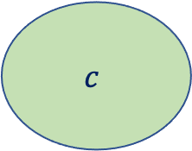



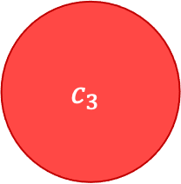


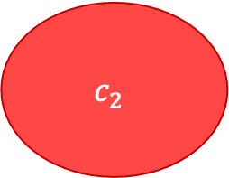


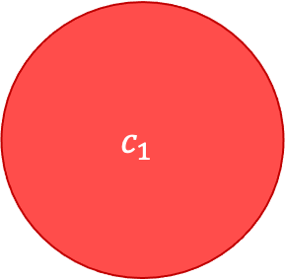



HCSC: Instance-wise Contrastive Selective Coding
Instance-wise CL: embed similar instances nearby while embed those dissimilar ones far apart
ICSC:
select more precise negative samples
similarity with c is less prominent compared its similarity with other clusters at the same hierarchy.
$$c_{3}$$
$$z_{3}$$
$$c_{1}$$
$$z_{1}$$
$$z_{1}$$
Augmentation 1
$$z$$
$$z_{2}$$
$$x_{i}$$
$$c$$
$$c_{2}$$
Augmentation 2
$$z^{′}$$
$$z$$
$$z_{2}$$
$$z_{3}$$

Slide 11
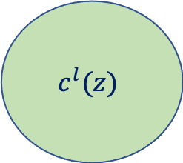
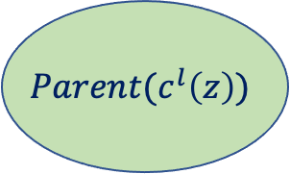
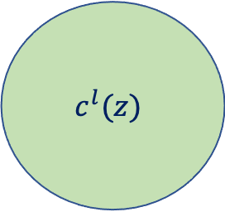
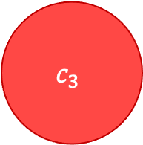
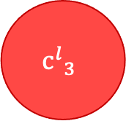
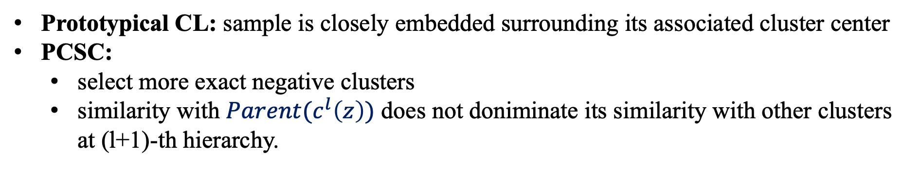
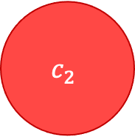
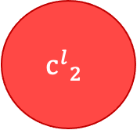
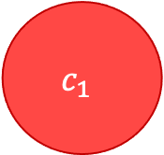
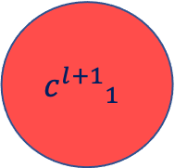
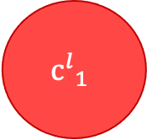


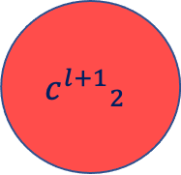
HCSC: Prototypical Contrastive Selective Coding
Prototypical CL: sample is closely embedded surrounding its associated cluster center
PCSC:
select more exact negative clusters
similarity with $Parent(c^{l}\left(z\right))$ does not doniminate its similarity with other clusters at (l+1)-th hierarchy.
$$c_{3}$$
$$c_{1}$$
$$Parent(c^{l}\left(z\right))$$
$${c^{l+1}}_{1}$$
$${c^{l+1}}_{2}$$
$$c^{l}(z)$$
$$z$$
$$c_{2}$$
$$c^{l}(z)$$
$${c^{l}}_{3}$$
$${c^{l}}_{1}$$
$${c^{l}}_{2}$$
$$z$$

Slide 12
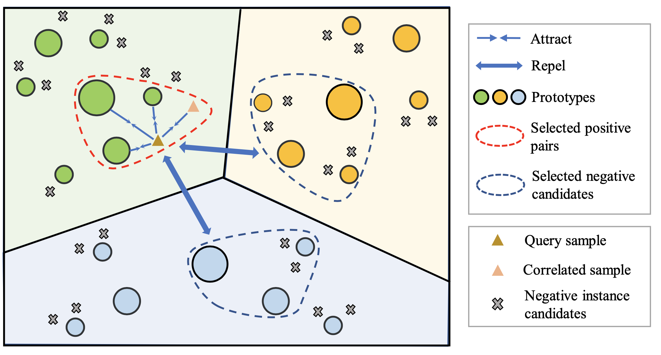
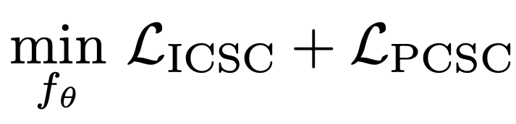
HCSC: Overall Objective
Instance-wise contrastive learning: exploits the local instance-level structures
Prototypical contrastive learning: constructs global semantic structures in the latent space

Slide 13
Outline
Introduction
Preliminaries
HCSC
Experiments
Conclusions

Slide 14
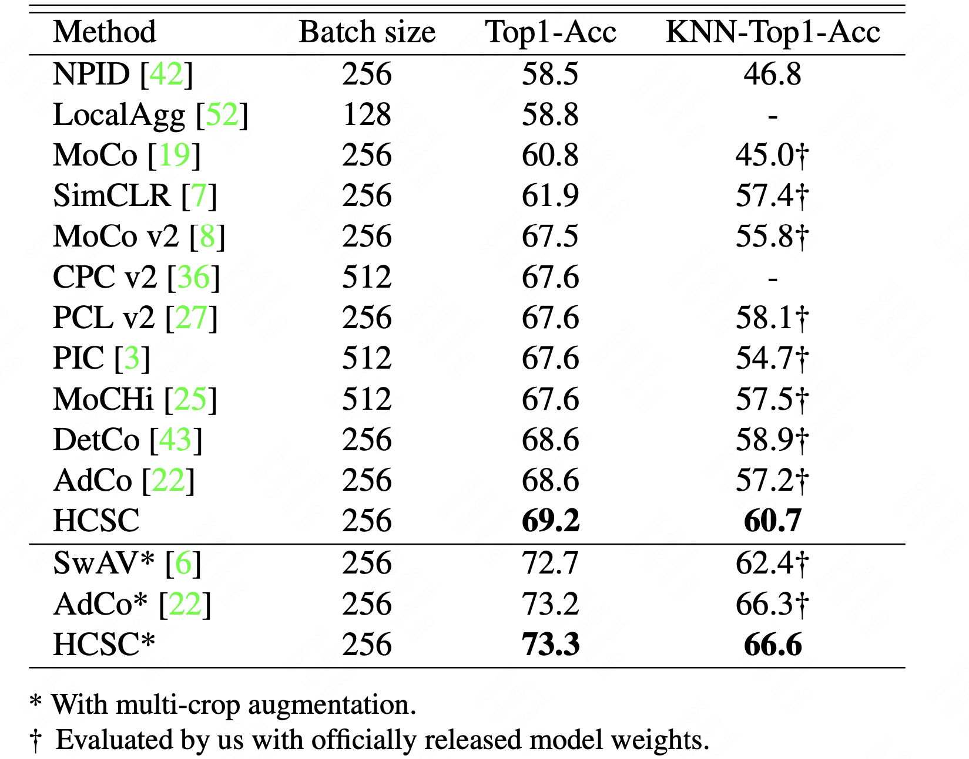
Experiments: Linear Classification and KNN Evaluation
Conclusions:
outperforms all baseline methods
outperforms the SOTA approach, AdCo.
surpasses PCL v2.

Slide 15
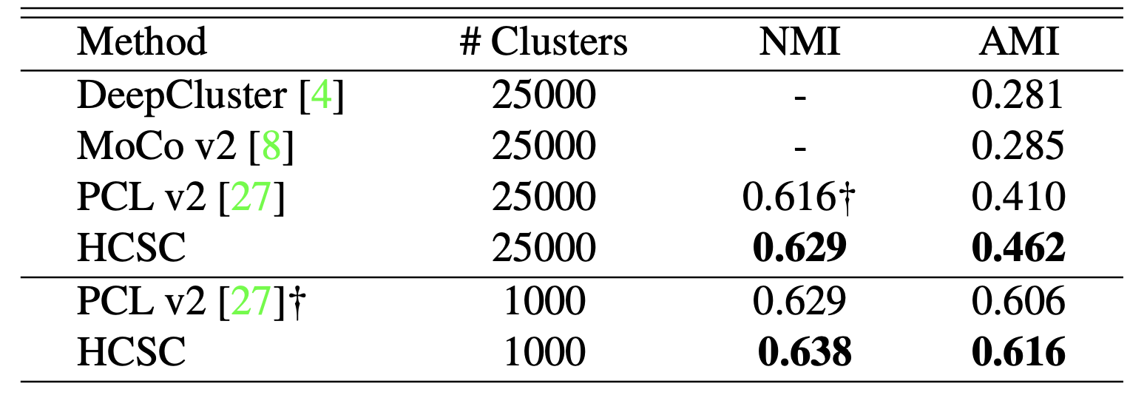
Experiments: Clustering
Conclusion:
The semantic hierarchies established can indeed improve the clustering quality.

Slide 16
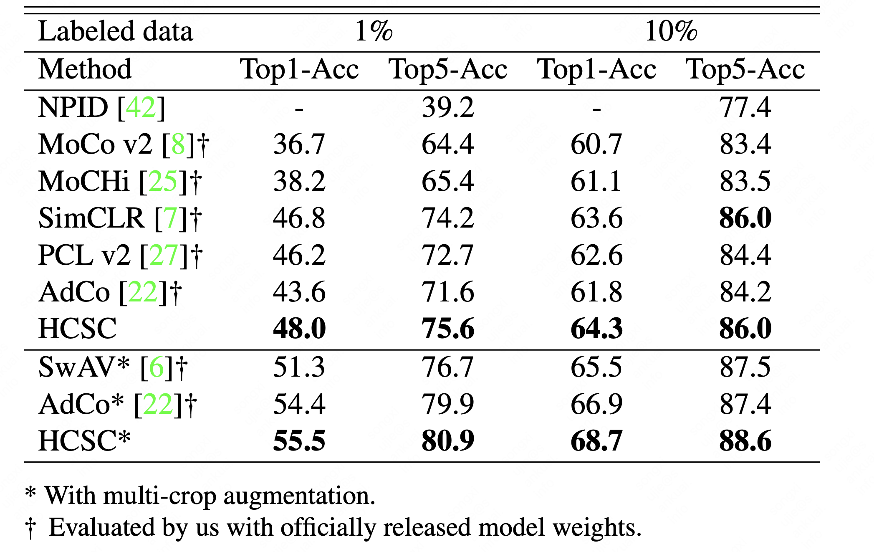
Experiments: Semi-supervised Learning.
Conclusion:
Representations learned by HCSC possess decent global semantic structures that benefit the learning from insufficient data.

Slide 17
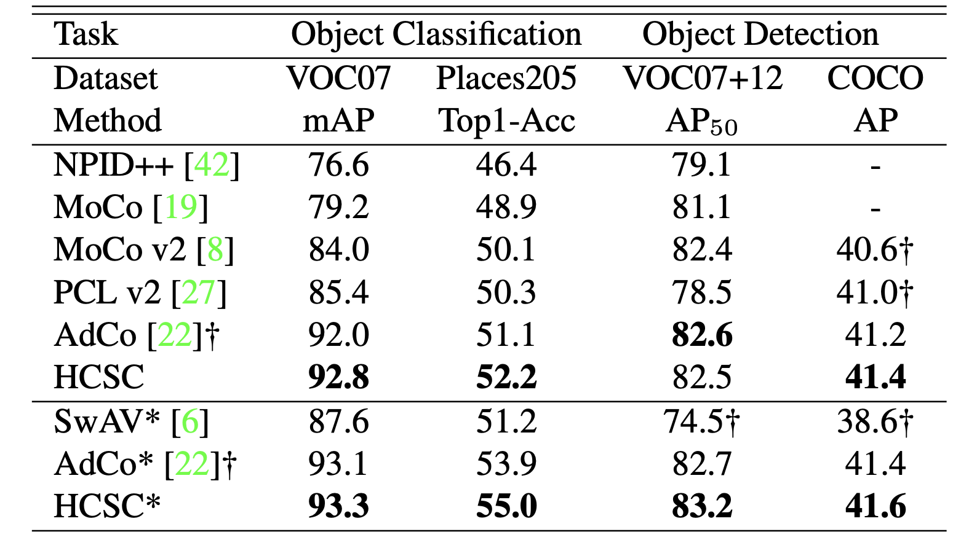
Experiments: Transfer Learning
Conclusion:
the image encoder learned by HCSC succeeds in capturing critical visual patterns shared across different image datasets.

Slide 18
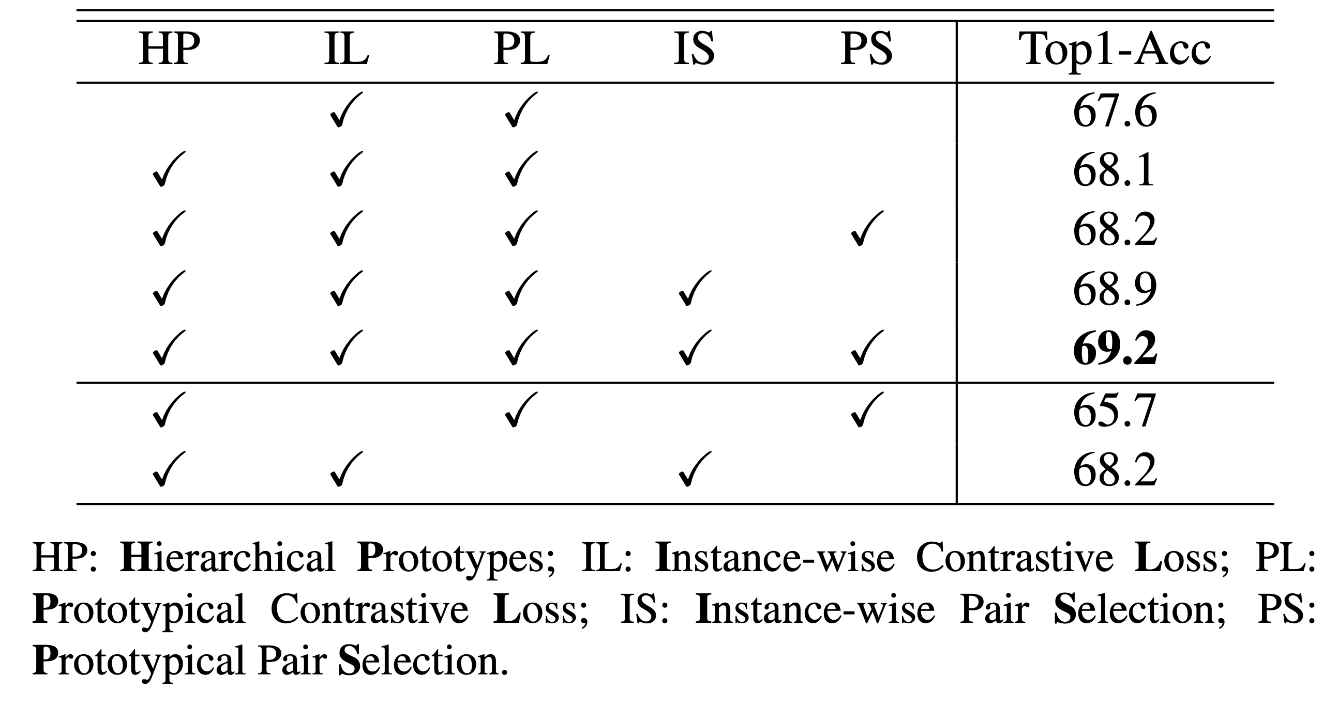
Experiments: Ablation Study
Conclusion:
the complementarity of two pair selection schemes.
the complementarity of two kinds of contrastive losses.

Slide 19
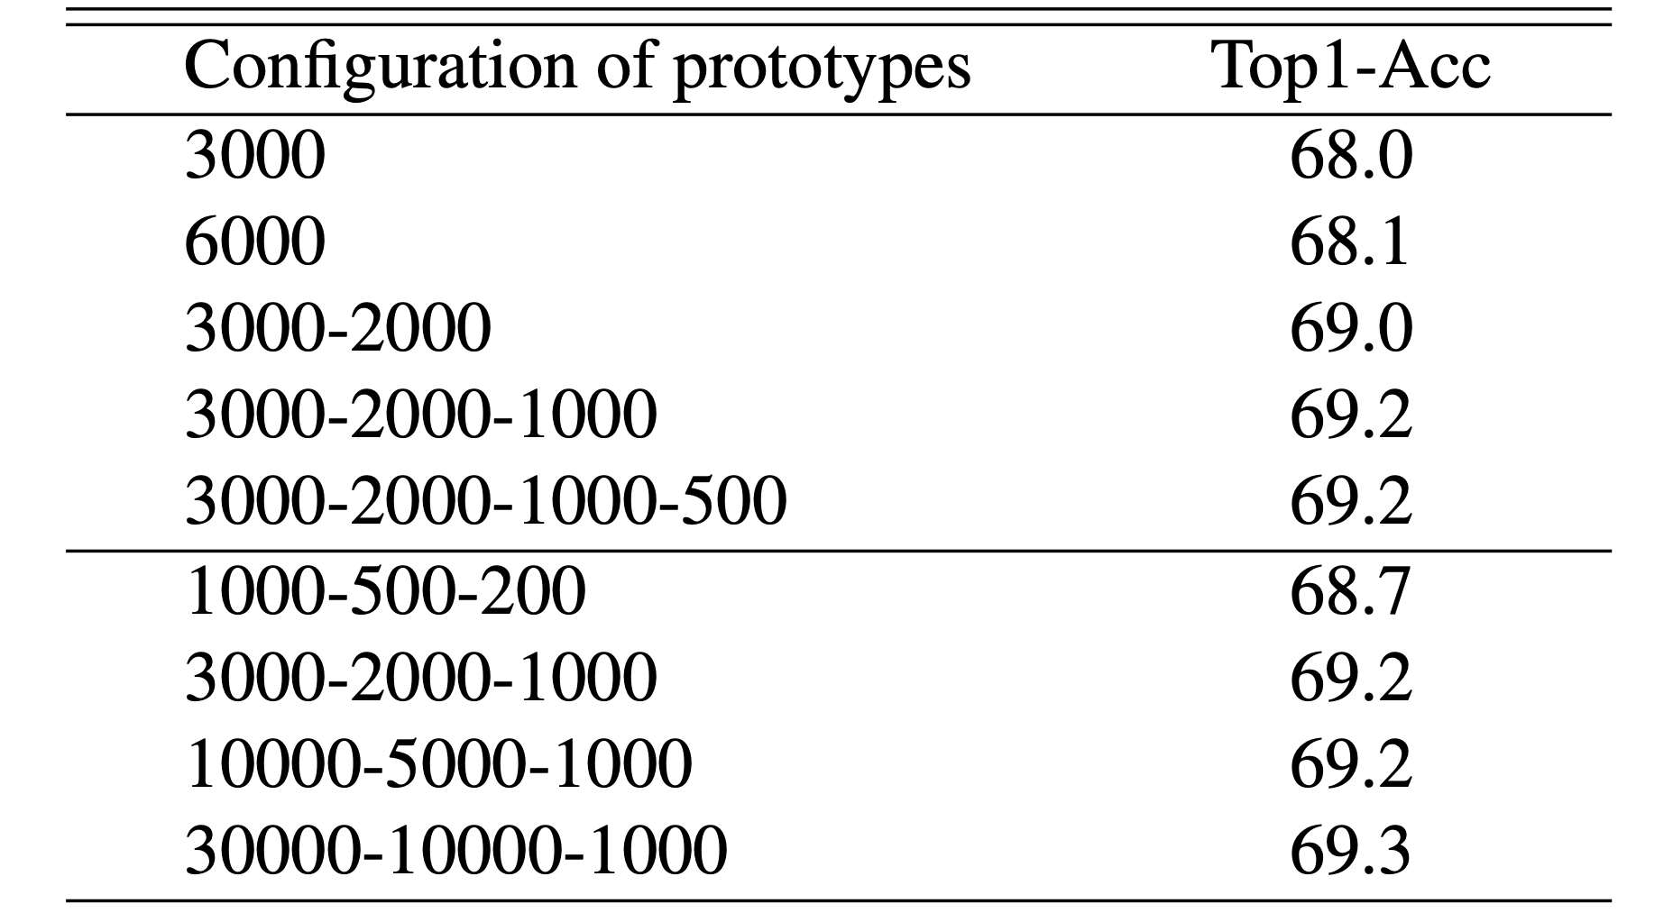
Experiments: Sensitive Analysis
Conclusion:
more semantic hierarchies (3 or 4) benefit model’s performance.
using abundant prototypes to fully capture the semantic clusters underlying the data is beneficial.

Slide 20
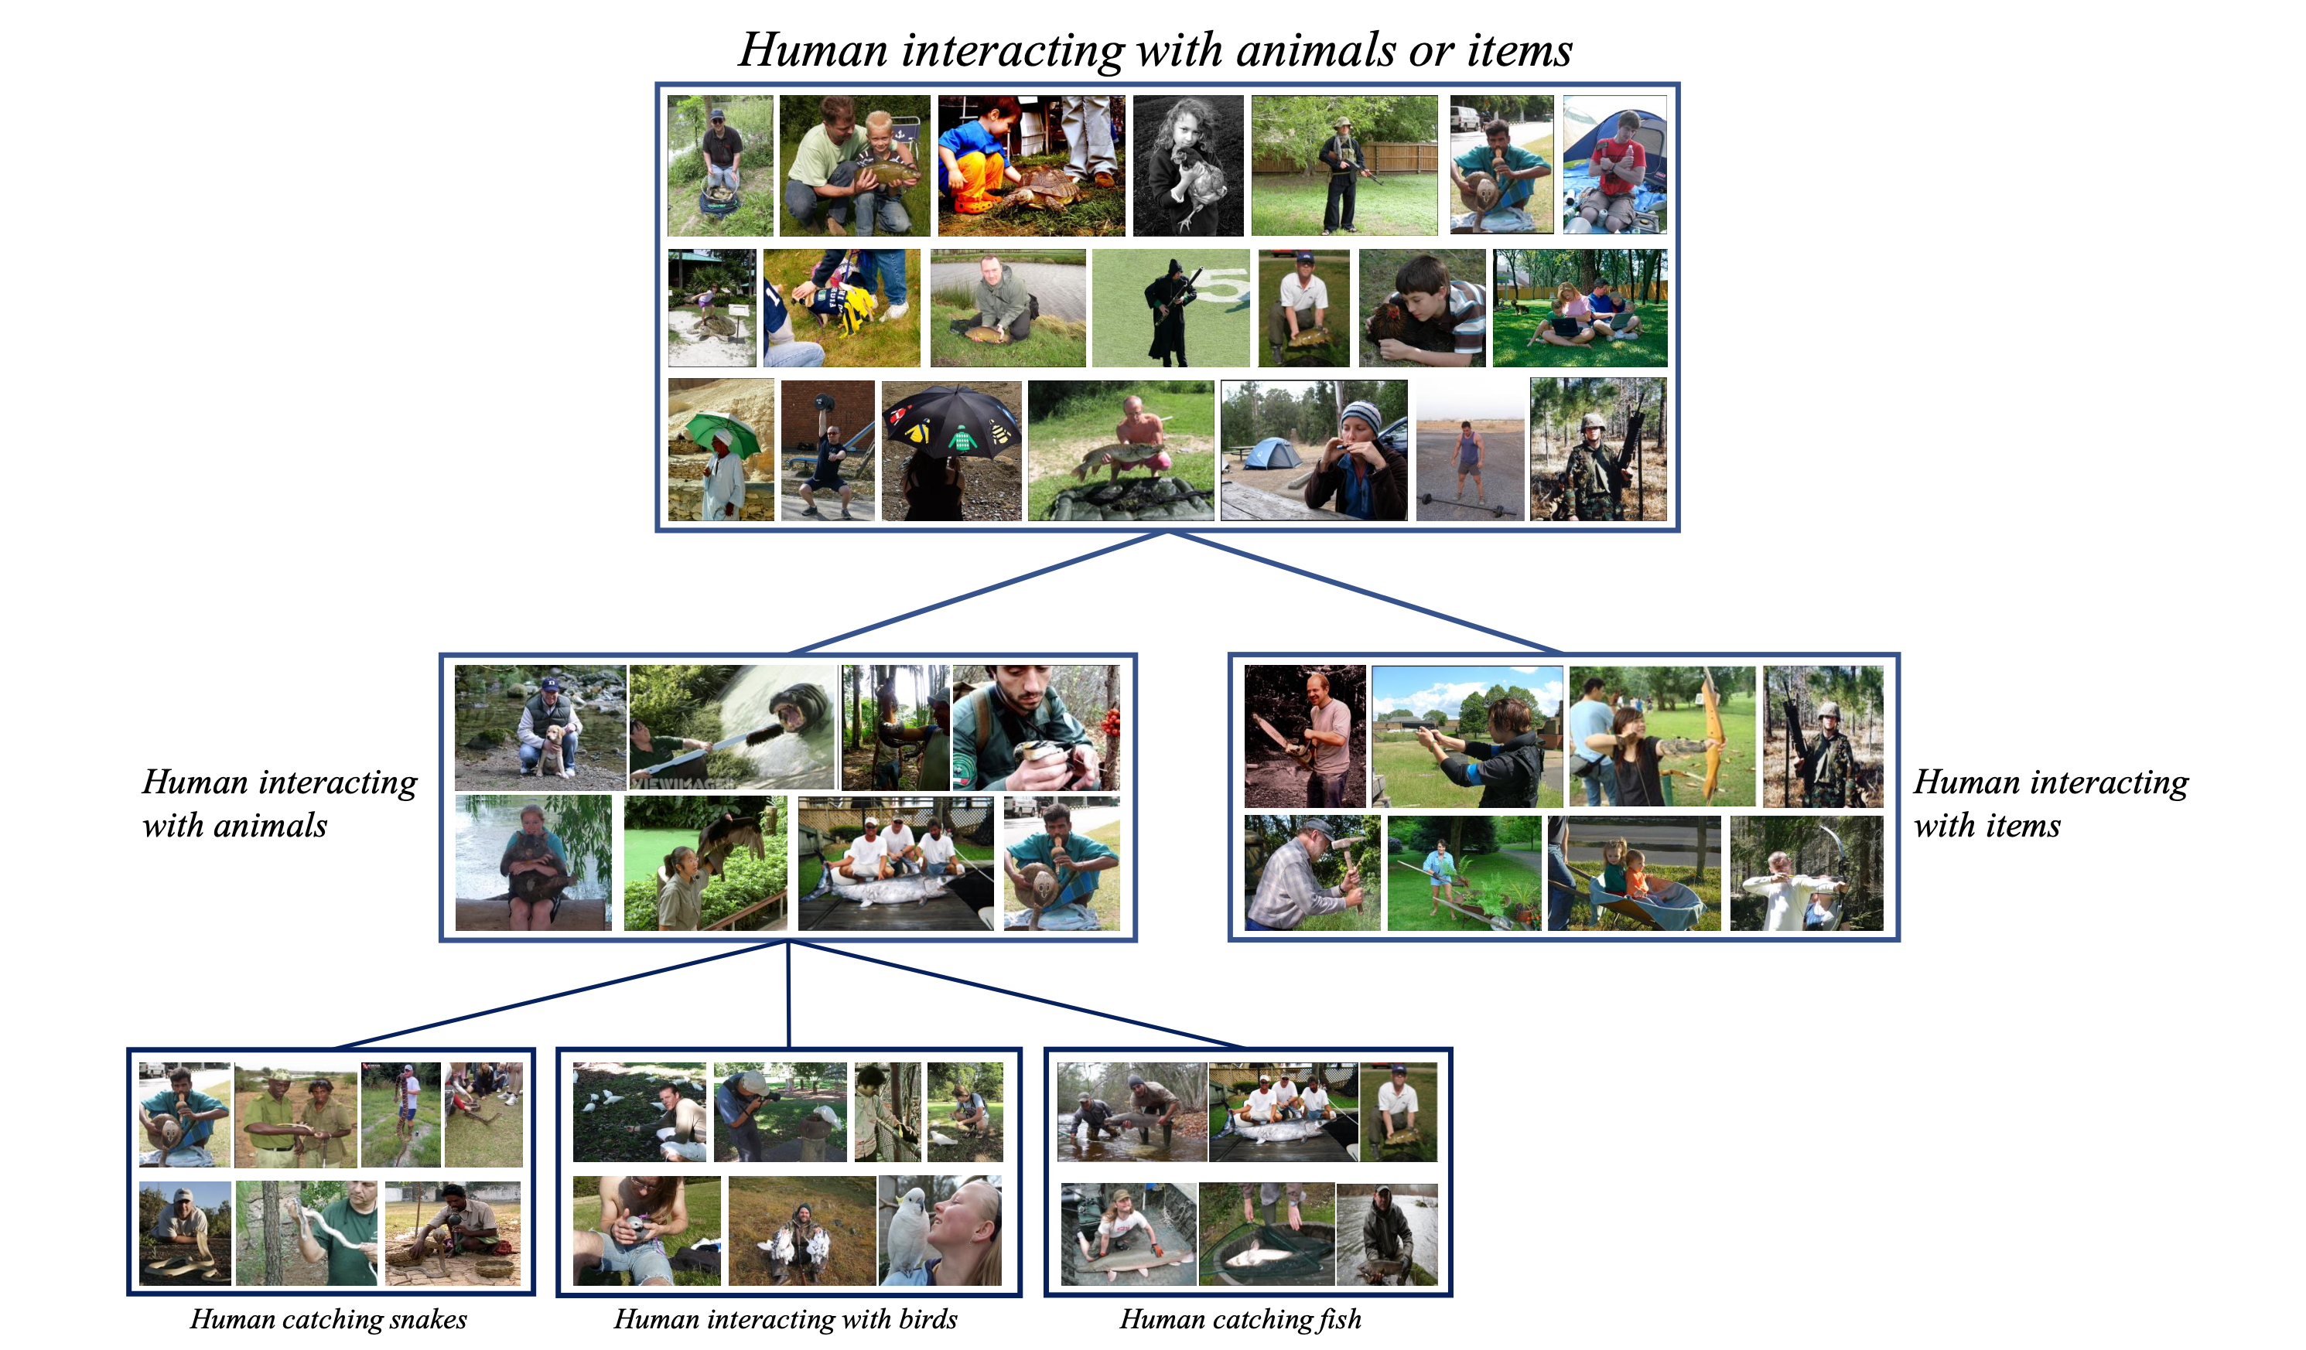
Experiments: Visualization

Slide 21
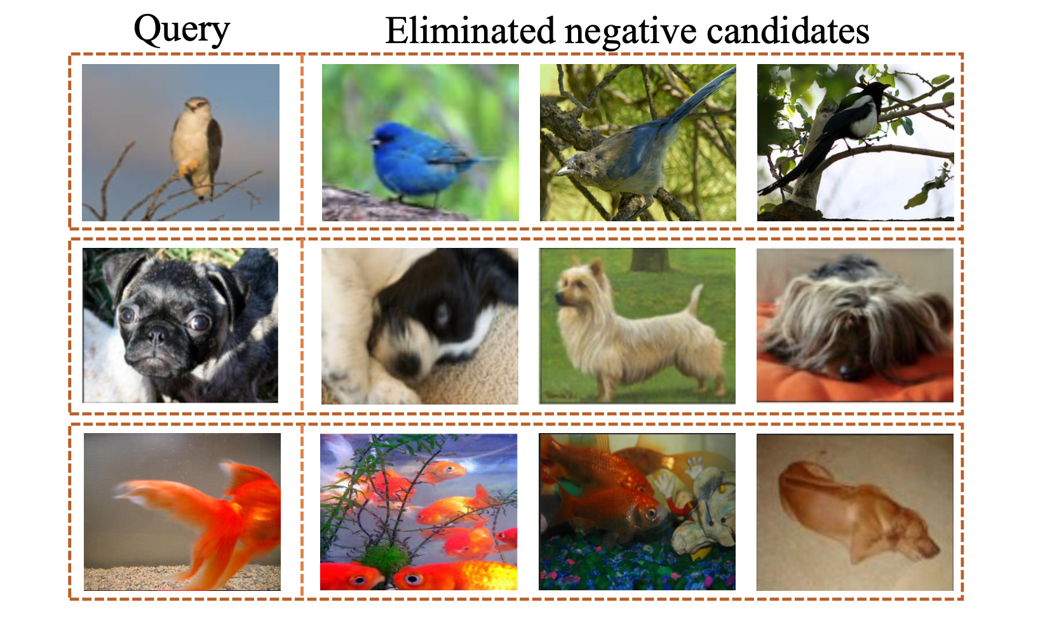
Experiments: Visualization
Conclusion:
Most of eliminated candidates own similar semantics with the query.

Slide 22
Outline
Introduction
Preliminaries
HCSC
Experiments
Conclusions

Slide 23
Conclusions
Advantage:
Capture hierarchical structures in image datasets.
A novel pair selection scheme to better select positive and negative pairs for contrastive learning.
Future works:
The hierarchical prototypes discovered are discarded in downstream tasks.
Hierarchical semantic structures naturally exist in image datasets, also text datasets, e.g. knowledge graph.

Slide 24
Thanks ☺, any questions?

